Slide 1
Section 1
Babbacombe Bay Café description and evaluation
https://babbacombebaycafe.co.uk/

Slide 2
Babbacombe Bay Café Website
What it is

Slide 3
User Goals
Booking tables
Opening hours
Menu (price, dietary requirements)
Location
Contact info
Social media
Offers
Images
Misc. (dog friendly…)

Slide 4
Task Scenarios
What (The task carried out)
Why (The goal of the task)
When (The circumstances/freq)
How (The sequence of actions leading up)
Where (The environment the task is carried out)
Who (The users involved in the task)

Slide 5
Task Scenarios
List the task scenarios

Slide 6
Mock Evaluation
(Was able to know task scenarios were good coz…)
Is this scenario realistic
Is the user able to understand what is being asked of them
Will the user understand how to give feedback
(Use this info to guide the survey creation and make any changes)

Slide 7
Survey
Create the google forms and question for the site

Slide 8
Participants
Anonymous responses
Demographic
Computer literacy
Homogeneity
Portential Bias but countered by informed knowledege

Slide 9

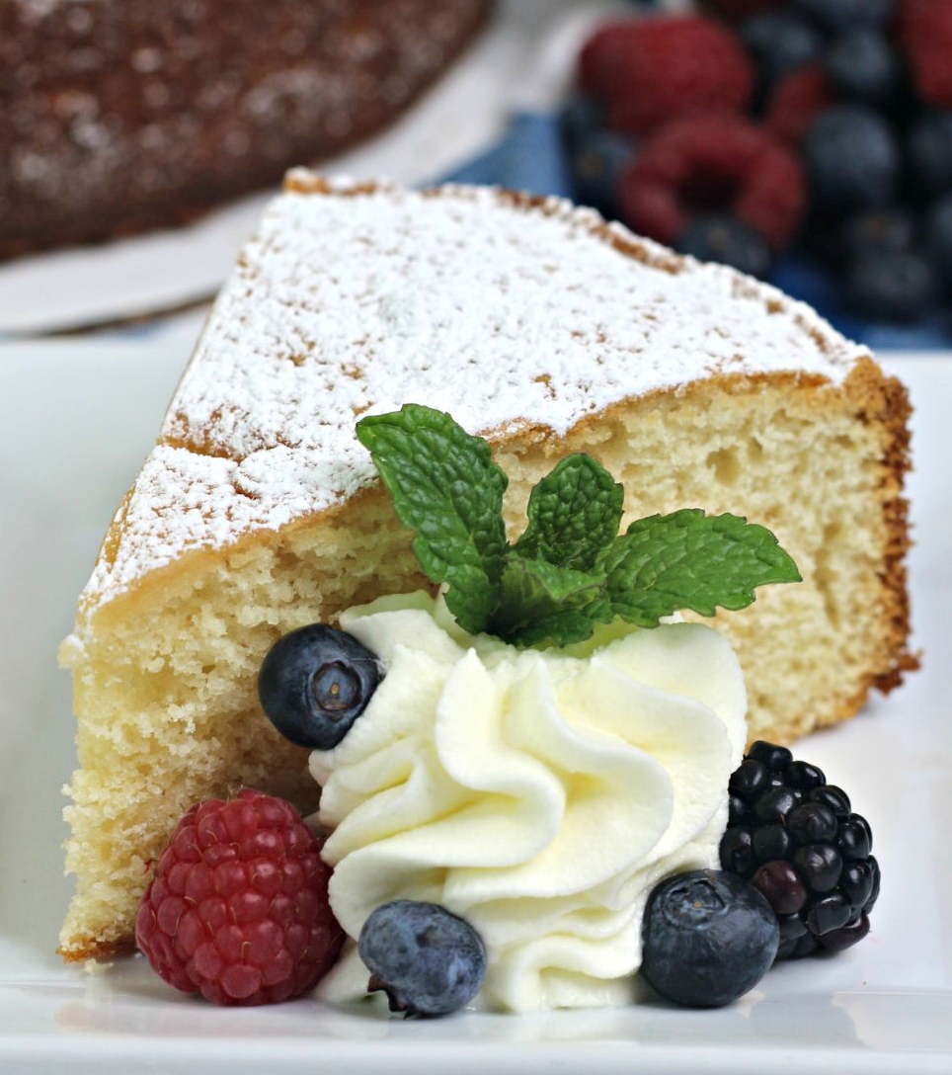

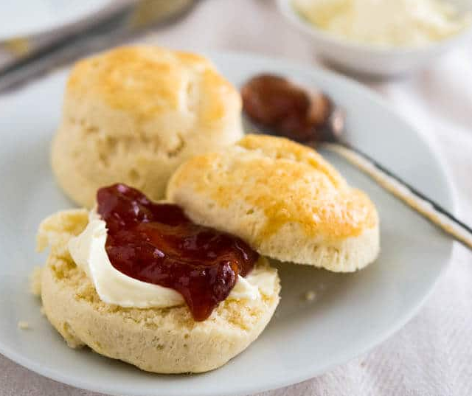
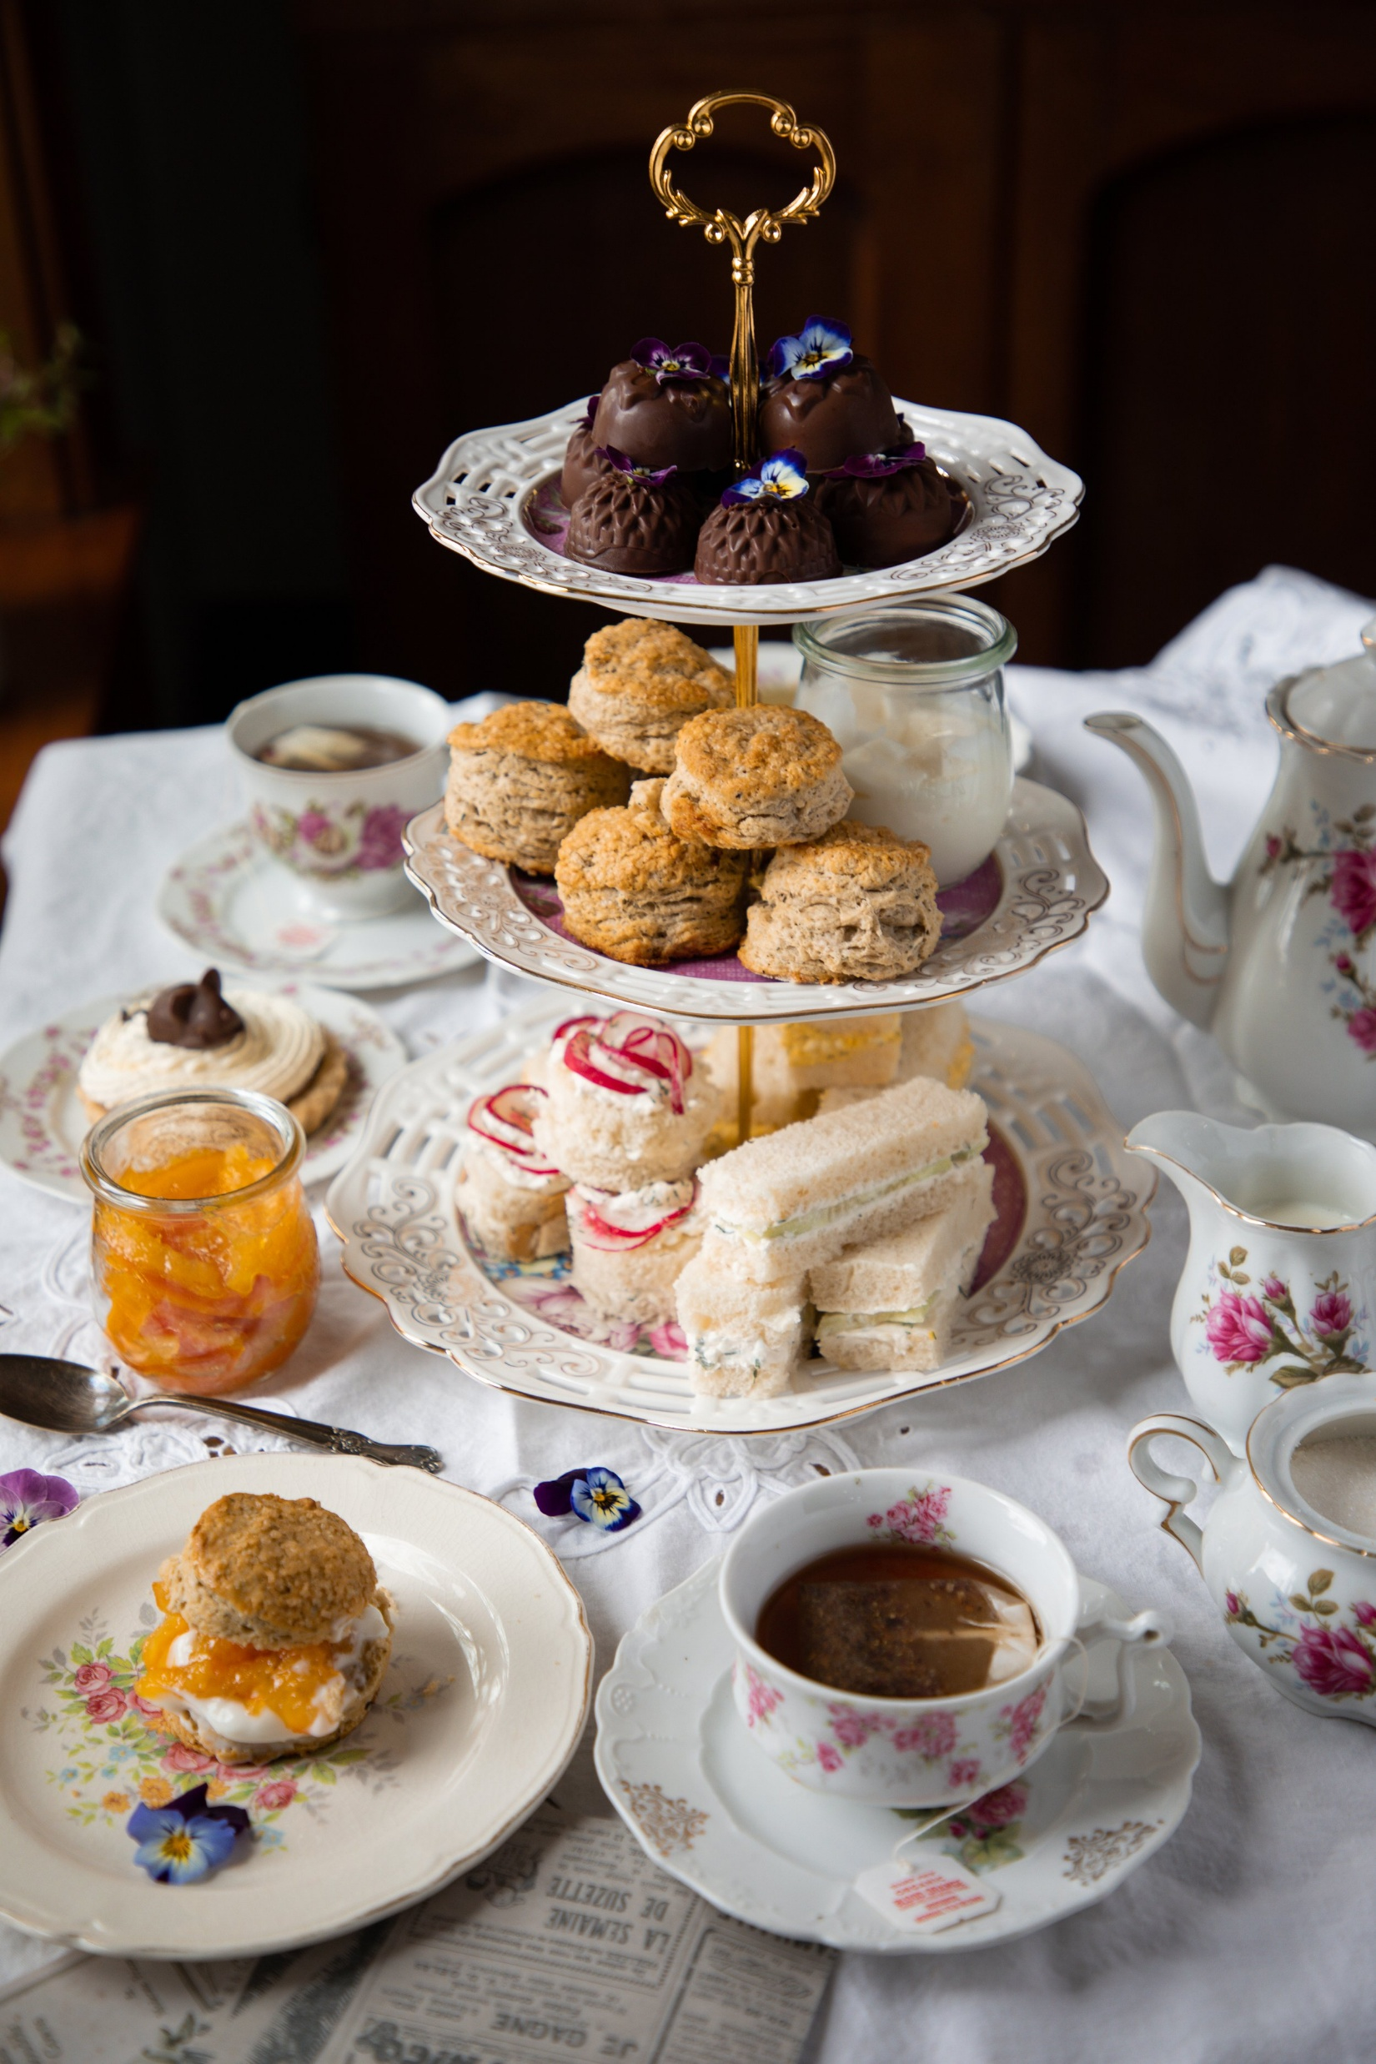
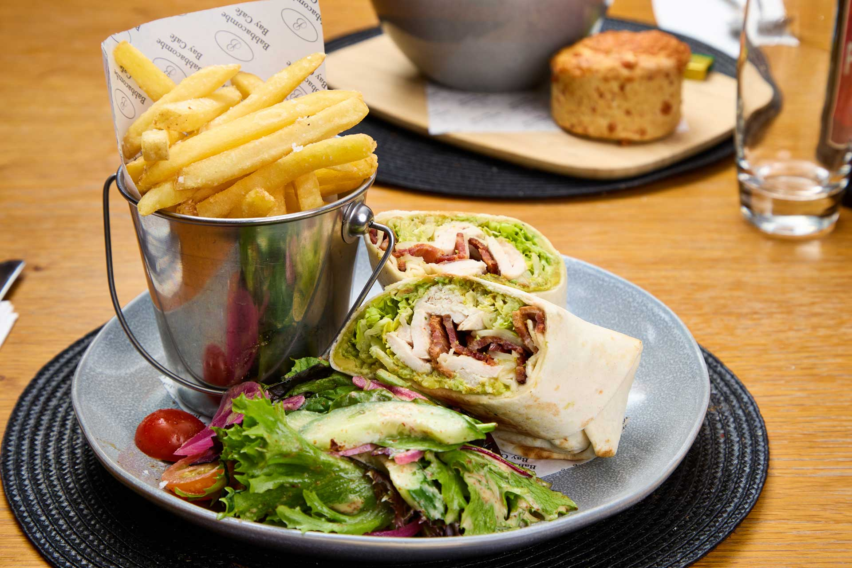


Mood Board

Slide 10
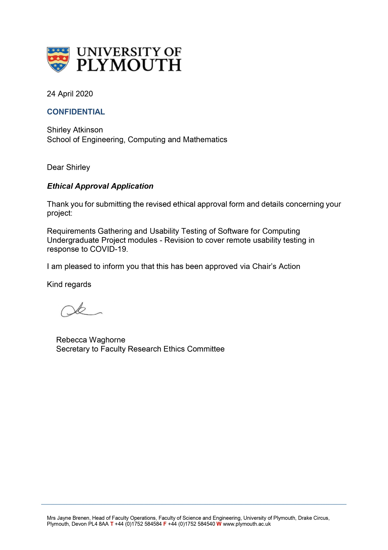
Documentation
University of Plymouth Ethics Approval
Research Information sheet
Right to Withdraw
Ethics Consent Form
Exit questionnaire

Slide 11
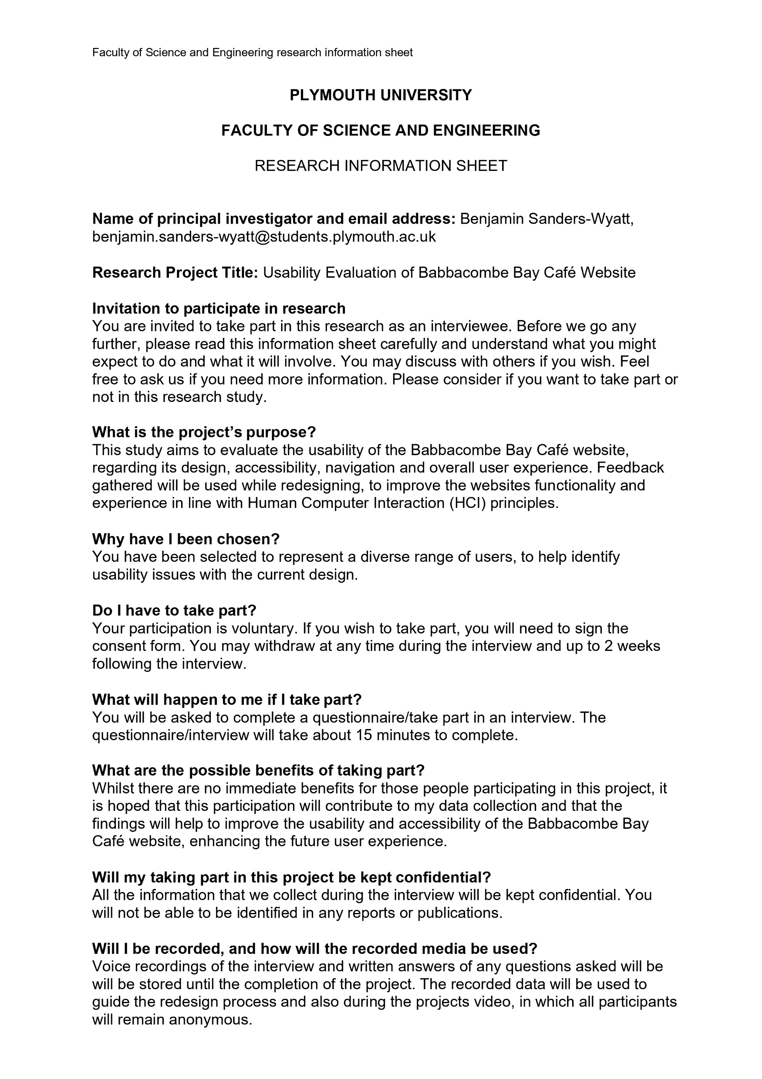
Documentation
University of Plymouth Ethics Approval
Research Information sheet
Right to Withdraw
Ethics Consent Form
Exit questionnaire

Slide 12
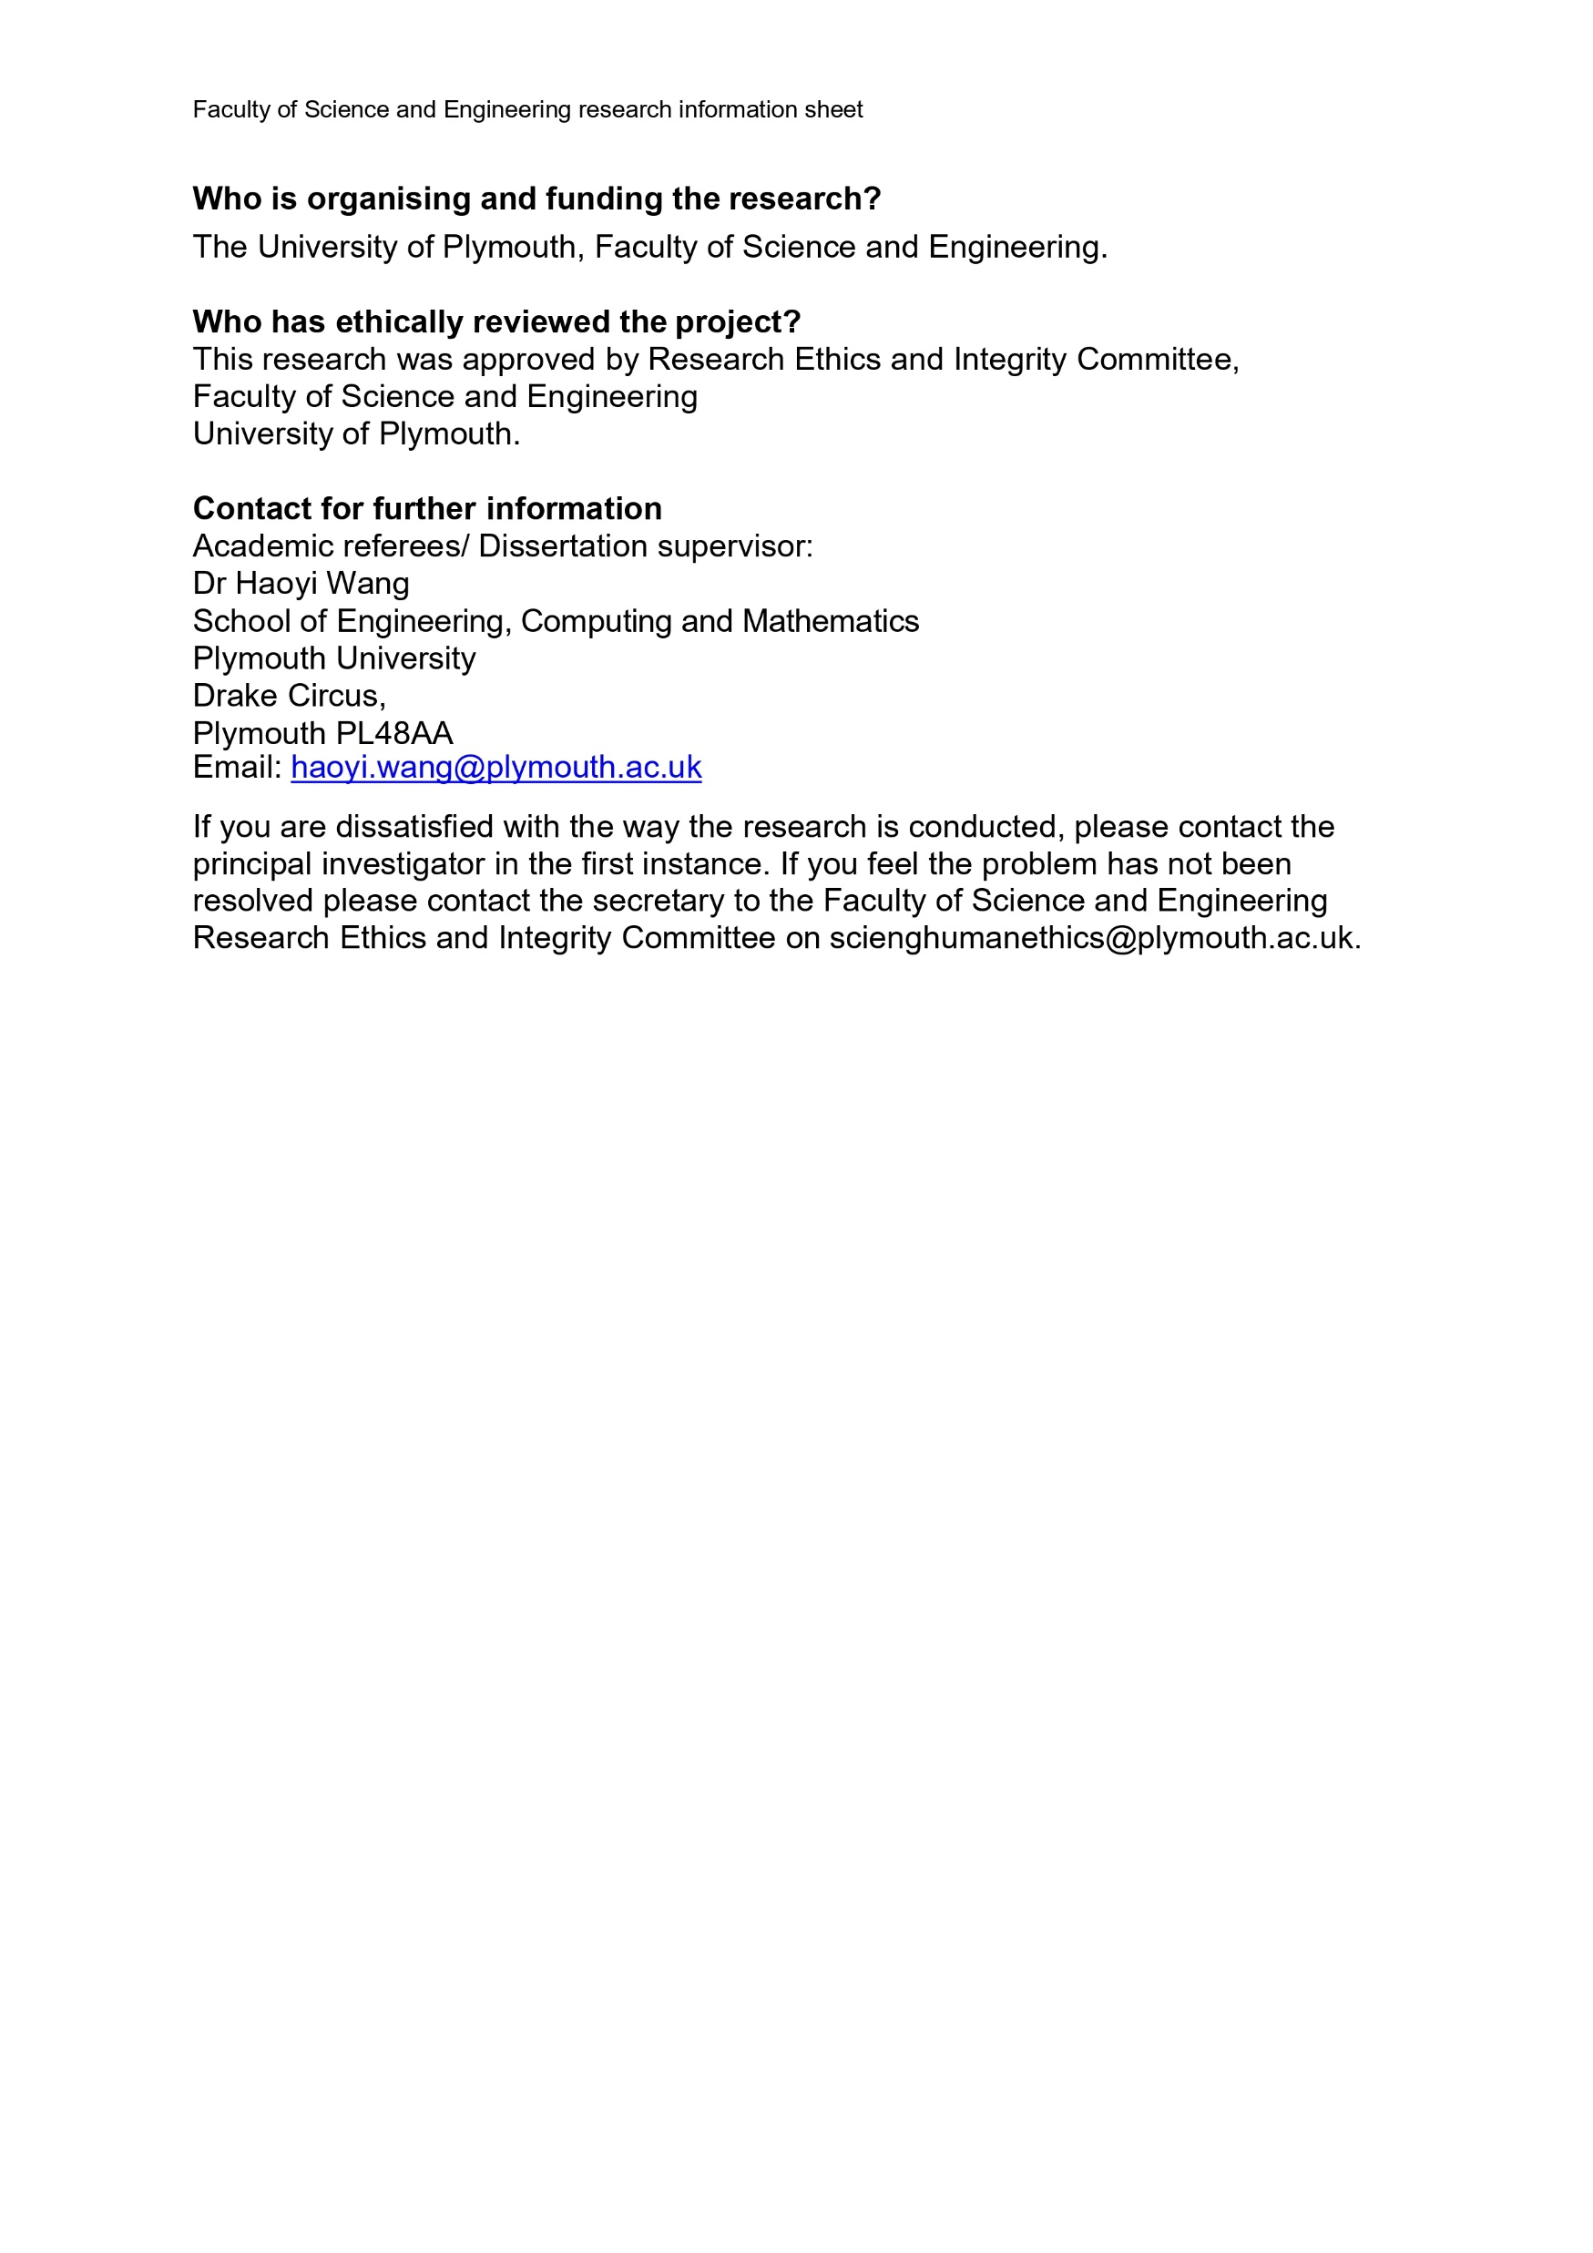
Documentation
University of Plymouth Ethics Approval
Research Information sheet
Right to Withdraw
Ethics Consent Form
Exit questionnaire

Slide 13
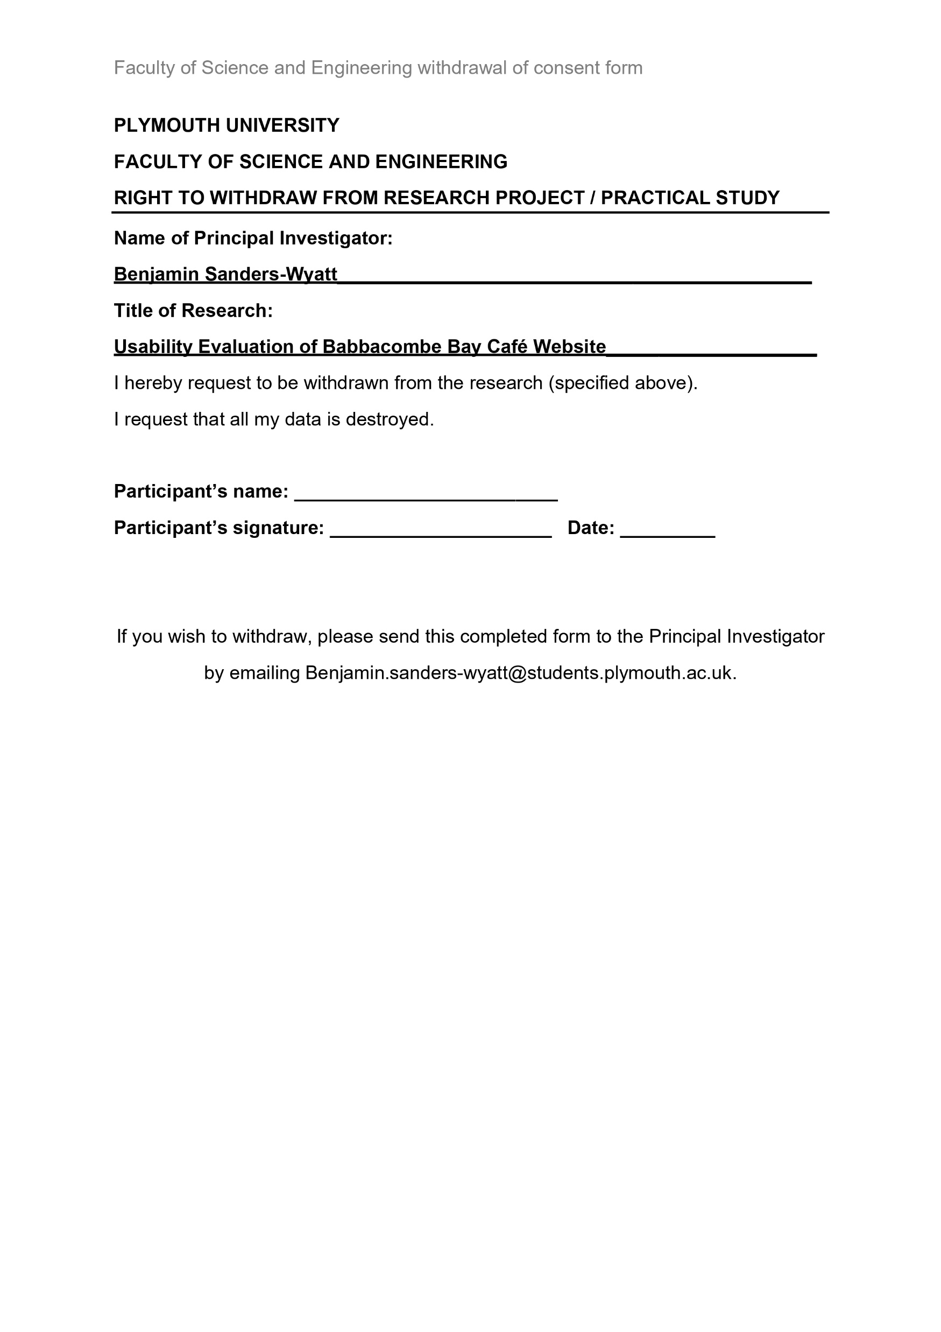
Documentation
University of Plymouth Ethics Approval
Research Information sheet
Right to Withdraw
Ethics Consent Form
Exit questionnaire

Slide 14
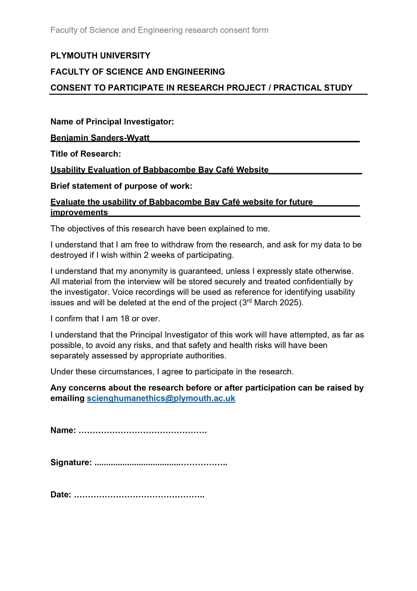
Documentation
University of Plymouth Ethics Approval
Research Information sheet
Right to Withdraw
Ethics Consent Form
Exit questionnaire

Slide 15
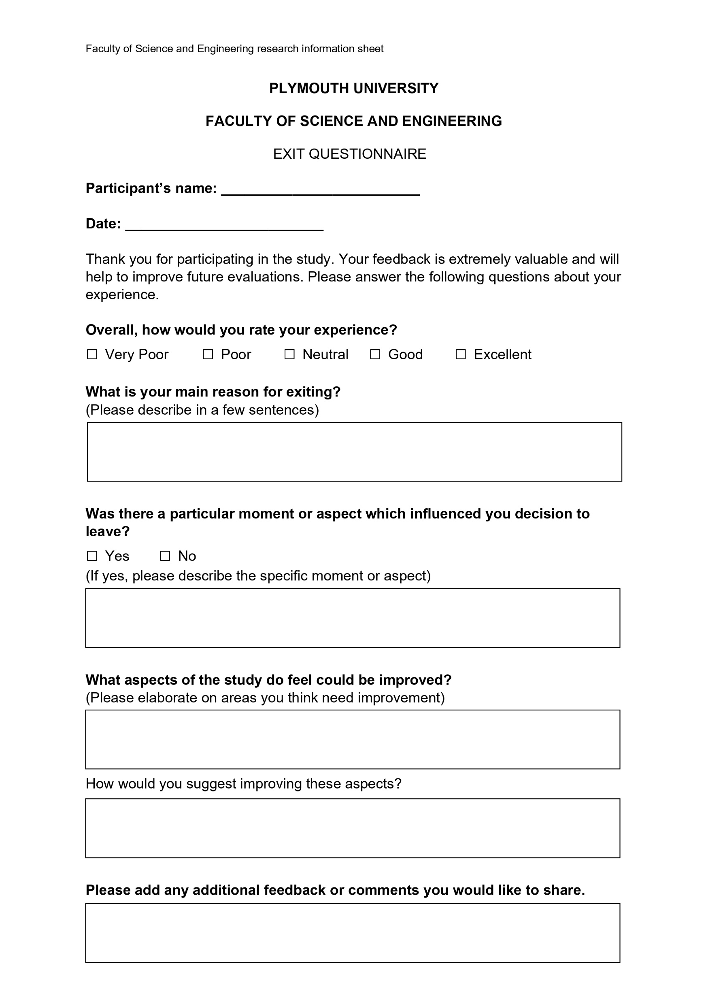
Documentation
University of Plymouth Ethics Approval
Research Information sheet
Right to Withdraw
Ethics Consent Form
Exit questionnaire

Slide 16
Section 2
Analysis and redesign process

Slide 17
Participants
Anonymous responses
Demographic
Computer literacy
Homogeneity
Portential Bias but countered by informed knowledege

Slide 18
Section 3
Redesign ideas

